Slide 1
Creating Your USI (Unique Student Identifier)
Northern Beaches SHS - 2015

Slide 2
What is a USI?
From January 1st, 2015 the Australian Government requires all students undertaking vocational training (VET) to have a USI. This 10 number and letter identifier will allow students to access their VET training records and results as a transcript from 2016 and beyond from their online USI account. Students often need to provide evidence of their academic achievements when applying for a job or to undertake further study so it is important that all students apply and attain their USI. Students at Northern Beaches SHS will not be able to have their qualifications awarded until they have acquired and returned their USI to the school.

Slide 3
What will happen with my USI?
The Head of Senior Schooling at Northern Beaches SHS will enter the USI into a student database system. It will also be accessible by the Queensland Curriculum and Assessment Authority who issue Queensland Certificates of Education (QCE) and report to the Australian Government on vocational outcomes.

Slide 4
What do I need to create my USI?
In order to apply for a USI you will need to have one of the following forms of identification:
Birth Certificate (Australian)
Driver’s License (this can be a Learners Permit)
Medicare Card
Australian Passport
Visa (with Non-Australian Passport) for international students
Certificate of Registration by Descent
Citizenship Certificate
Immi Card

Slide 5
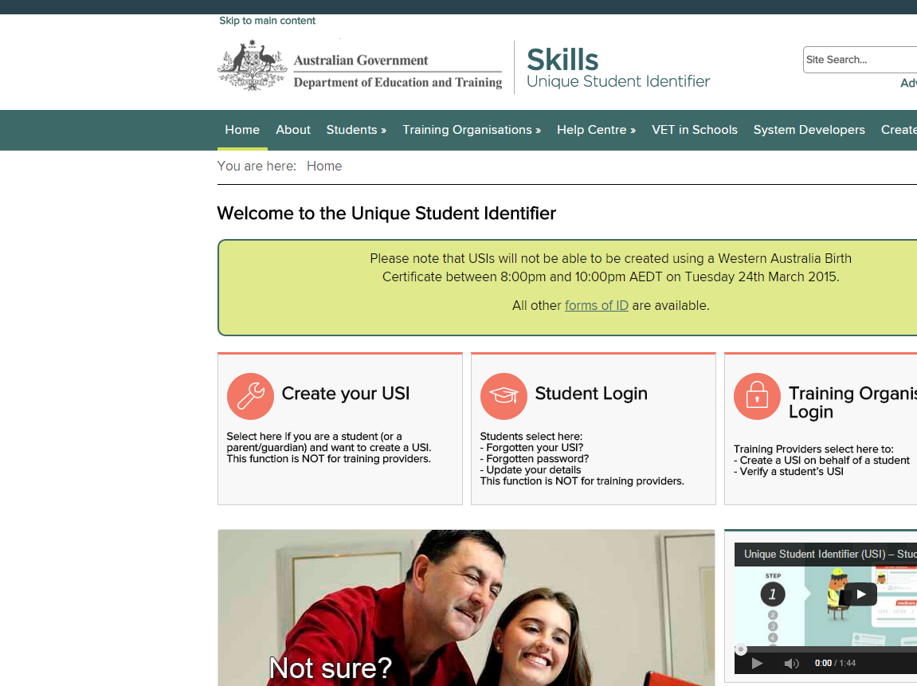
Step 1 – Log On
http://www.usi.gov.au/Pages/default.aspx select “Create your USI”

Slide 6
Step 2 – Create a USI
Click “continue”

Slide 7
Step 3 – Agree to Terms & Conditions
Click both boxes as show in the picture and then click “next”

Slide 8
Step 4 – USI Student Portal
Click “Create USI”

Slide 9
Step 5A – Personal Details
Fill out your personal details. You will need to scroll down for Step 5B.

Slide 10
Step 5B – Contact Details
Complete the contact details section. Remember for most of you your mobile will be the easiest contact as you have this with you regularly.
Once completed, click “next”

Slide 11
Step 6 – Evidence of Identity
Indicate which one form of ID you will be using.
Click “next”

Slide 12
Step 7 – Verification of Identity
Fill in the evidence of identify section. This example has been done using a Queensland Drivers License
Click “next”

Slide 13
Step 8 – Your USI Password
Set a password and questions and answers that you would remember if you ever forgot your password and needed to log on via training.gov.au

Slide 14
Step 9 – You’ve Created Your USI
You have successfully created your USI. This will be emailed or texted to you depending on the contact detail you provided in Step 5B.

Slide 15
Step 10 – Recording Your USI
You now need to complete this small piece of paper and give it back to your teacher. Mr Hustler will keep this and record your USI so the school can issue you Certificates.

